Slide 1
Inferential Statistics and Hypothesis Testing 27th May, 2019
Topic to be covered:
Random Variables and Expected Value
Probability Distribution Functions
Normal Distribution Function
Sampling and sampling distribution
Central Limit Theorem
Null/Alternate Hypothesis Testing
Critical Value Method of testing hypothesis
P-value method
Types of Errors
T-Test

Slide 2
Section I: Inferential Statistics

Slide 3
Random Variable
A random variable, usually written X, is a variable whose possible values are numerical outcomes of a random phenomenon.
There are two types of random variables, discrete and continuous.
Discrete random variables take on a countable number of distinct values. Consider an experiment where a coin is tossed three times. If X represents the number of times that the coin comes up heads, then X is a discrete random variable that can only have the values 0, 1, 2, 3 (from no heads in three successive coin tosses to all heads). No other value is possible for X.
Continuous random variables can represent any value within a specified range or interval and can take on an infinite number of possible values. An example of a continuous random variable would be an experiment that involves measuring the amount of rainfall in a city over a year, or the average height of a random group of 25 people.

Slide 4
Expected Value
Expected value of a random variable, intuitively, is the long-run average value of repetitions of the same experiment it represents
The expected value is calculated by multiplying each of the possible outcomes by the likelihood each outcome will occur, and summing all of those values
In case of rolling a dice, there are 6 possible outcome, 1, 2, 3, 4, 5, 6 with equal probability.
So, the expected value will be 1/6 x (1+2+3+4+5+6) = 21/6 = 3.5
Or, the expected value of a discrete random variable is the probability-weighted average of all possible values

Slide 5
Discrete Distributions
A discrete distribution is a statistical distribution that shows the probabilities of outcomes with finite values.
Ex: Binomial Distribution
The binomial distribution with parameters n and p is the discrete probability distribution of the number of successes in a sequence of n independent experiments, each asking a yes–no question, and each with its own boolean-valued outcome: success/yes/true/one (with probability p) or failure/no/false/zero (with probability q = 1 − p).
A single success/failure experiment is also called a Bernoulli trial or Bernoulli experiment and a sequence of outcomes is called a Bernoulli process; for a single trial, i.e., n = 1, the binomial distribution is a Bernoulli distribution. The binomial distribution is the basis for the popular binomial test of statistical significance

Slide 6
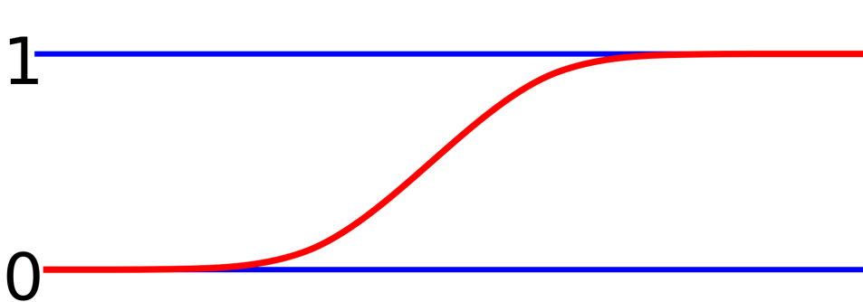
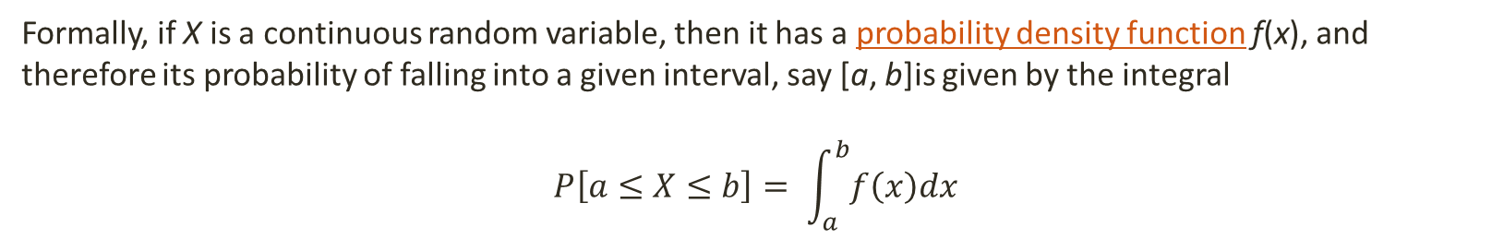
Continuous Distributions
A distribution function for a continuous random variable is a continuous distributions.
It is defined by probability density function and the cumulative distribution function of such distributions is continuous.
Formally, if X is a continuous random variable, then it has a probability density function ƒ(x), and therefore its probability of falling into a given interval, say [a, b]is given by the integral
$$P\left[a≤X≤b\right]= \int_{a}^{b}{f\left(x\right)dx}$$

Slide 7
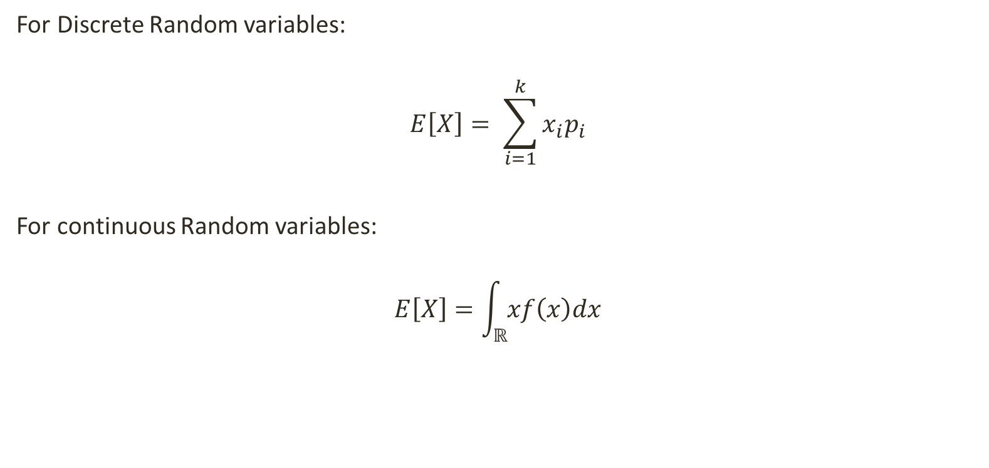
Expected Value of distribution
For Discrete Random variables:
$$E\left[X\right]= \sum_{i=1}^{k}{x_{i}p_{i}}$$
For continuous Random variables:
$$E\left[X\right]=\int_{ℝ}^{ }{xf\left(x\right)dx}$$

Slide 8
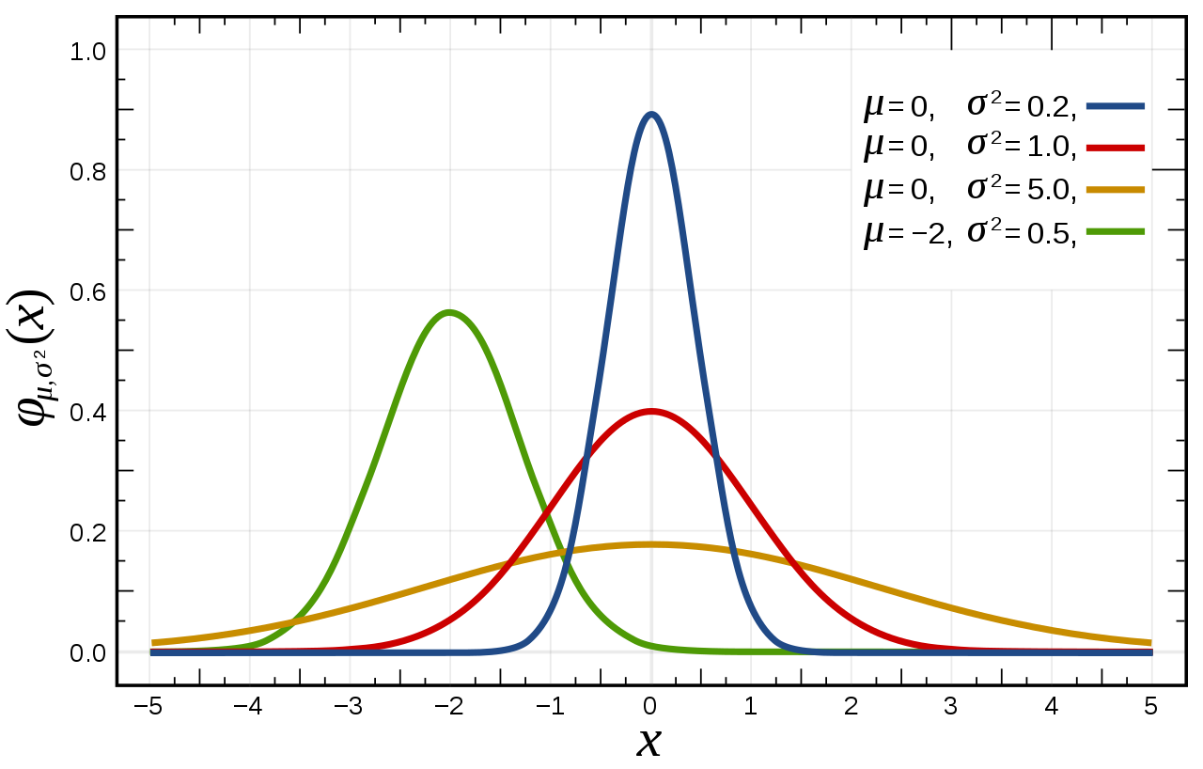
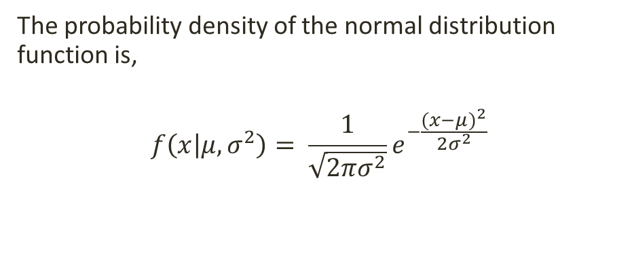
Normal distribution
Normal distribution, also known as the Gaussian distribution, is a probability distribution that is symmetric about the mean, showing that data near the mean are more frequent in occurrence than data far from the mean. In graph form, normal distribution will appear as a bell curve.
The standard normal distribution has two parameters: the mean and the standard deviation. For a normal distribution, 68% of the observations are within +/- one standard deviation of the mean, 95% are within +/- two standard deviations, and 99.7% are within +- three standard deviations.
The probability density of the normal distribution function is,
$$f\left(x | μ, σ^{2}\right)= \frac{1}{\sqrt{2πσ^{2}}}e^{−\frac{{(x−μ)}^{2}}{2σ^{2}}}$$

Slide 9
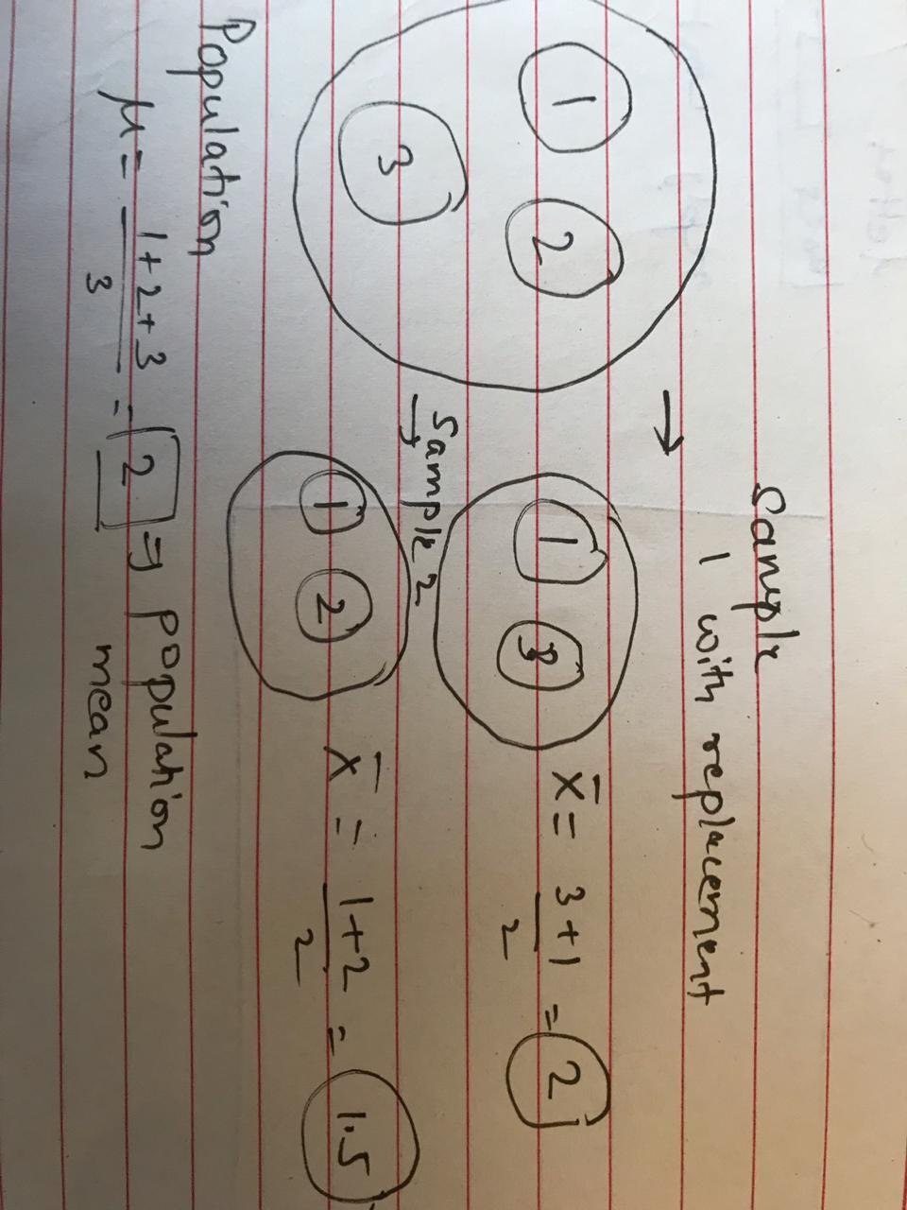
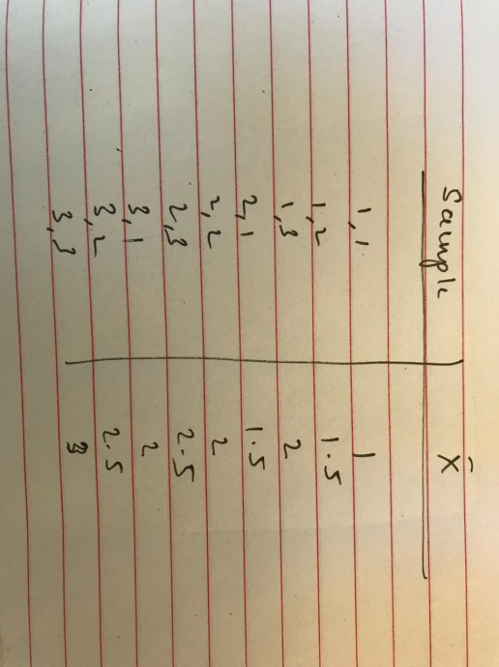
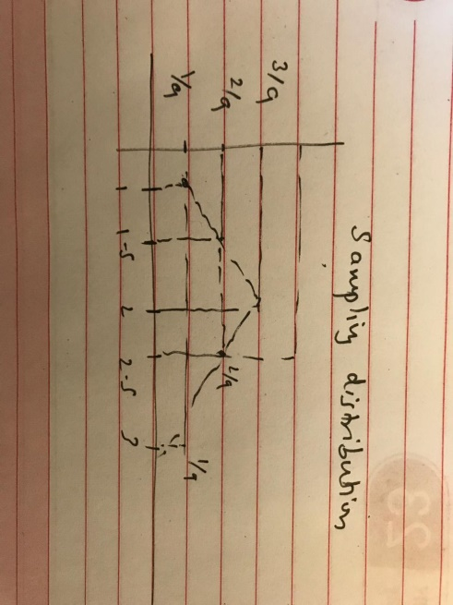
Sampling distribution
Sampling distribution is a probability distribution of a statistic obtained through a large number of samples drawn from a specific population.

Slide 10
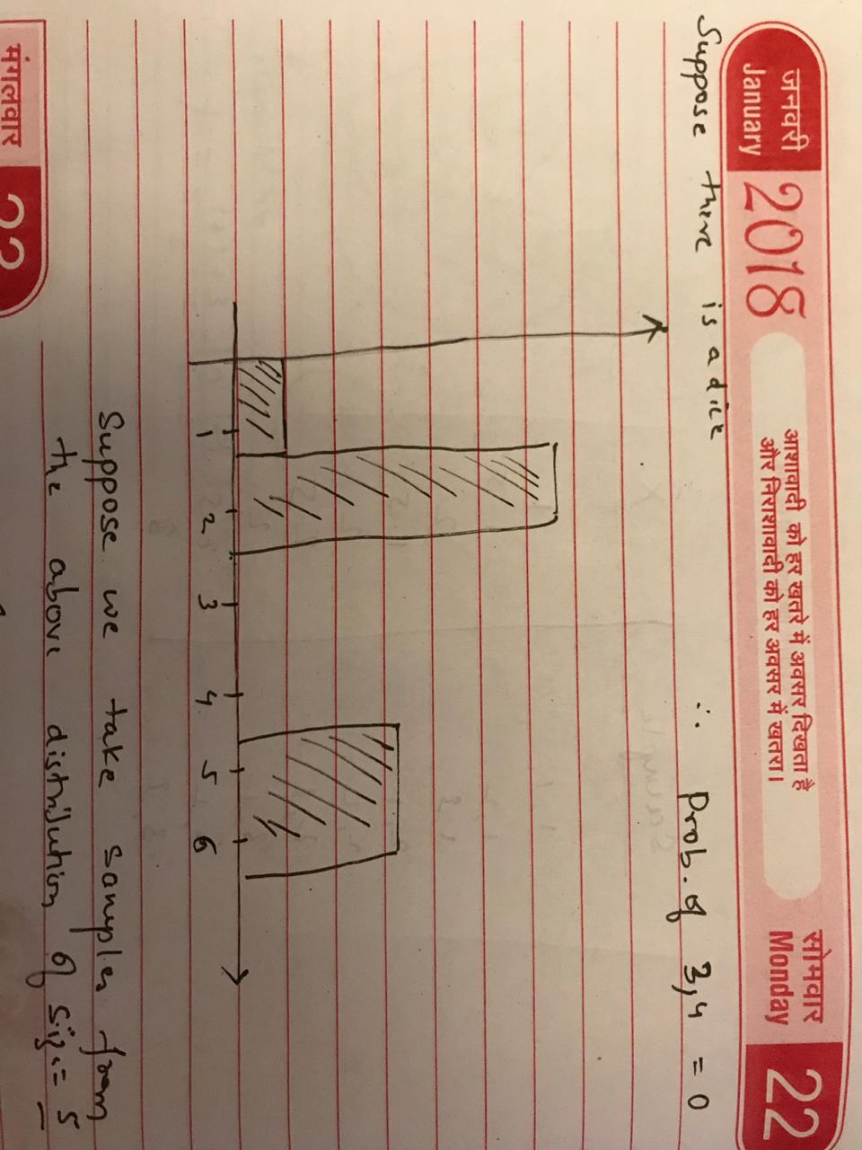
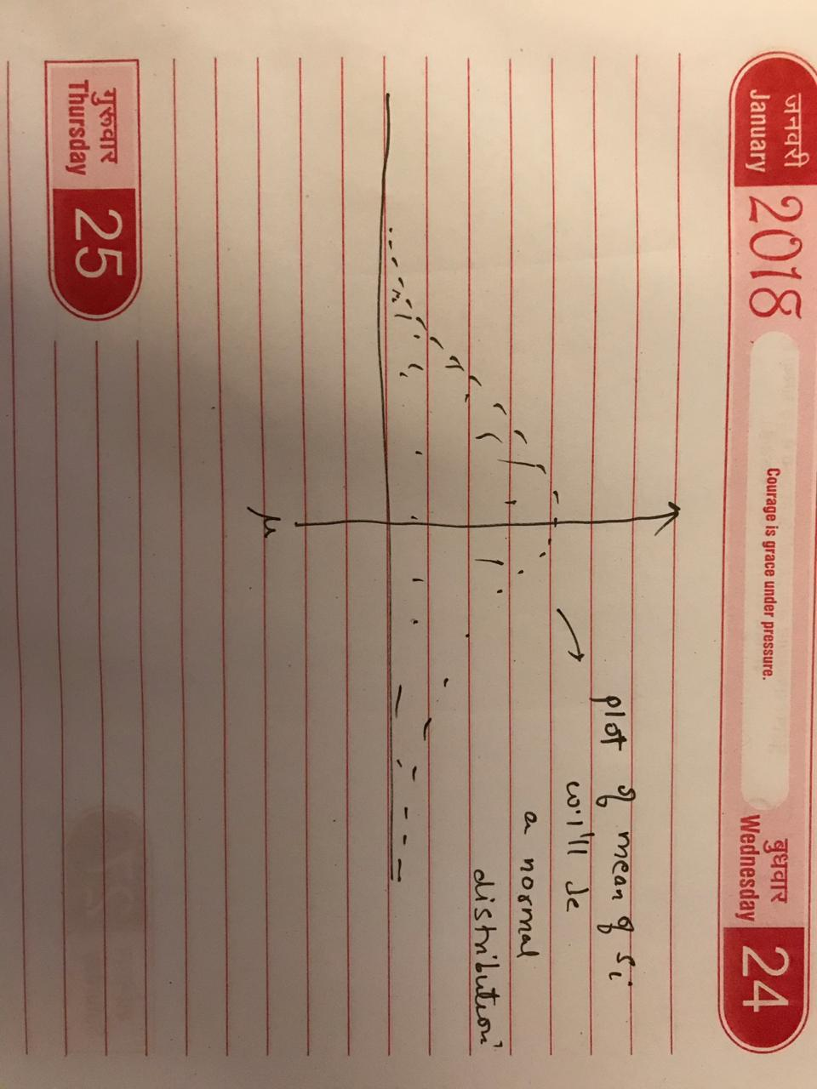
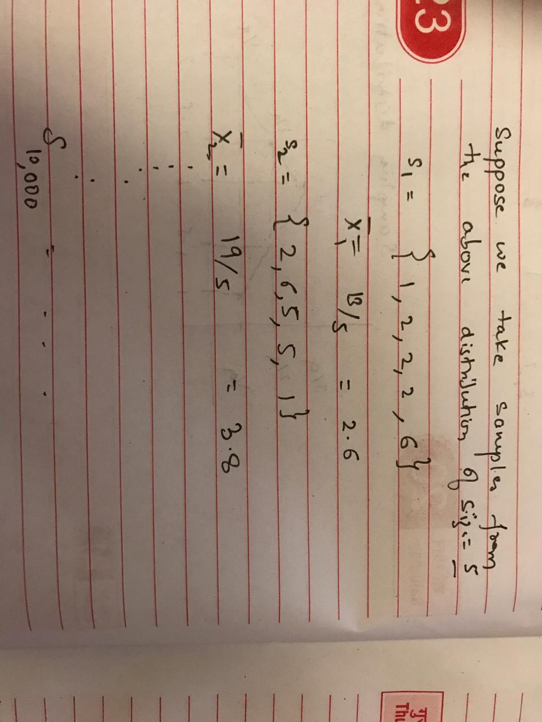
Central Limit Theorem
The central limit theorem (CLT) establishes that, in some situations, when independent random variables are added, their properly normalized sum tends toward a normal distribution (informally a "bell curve") even if the original variables themselves are not normally distributed.
http://onlinestatbook.com/stat_sim/sampling_dist/

Slide 11
Section II: Hypothesis Testing

Slide 12
Null/Alternate Hypothesis
Null Hypothesis is the by default setting which is present. Something which people already believe to be true.
Alternate Hypothesis is something which we suspect to be true and trying to prove through the experiment.
In other words, the alternative hypothesis is a direct contradiction of the null hypothesis
Example:
Suppose it is recommended that students should get at least 8 hours of sleep to be fit. However, the school principal suspects that students might be getting less than 8 hours of sleep.
In this case,
H0 = average sleep >= 8 hours
Ha = average sleep < 8 hours

Slide 13
Type I and Type II Errors
A type I error (or error of the first kind) is the incorrect rejection of a true null hypothesis. Usually a type I error leads one to conclude that a supposed effect or relationship exists when in fact it doesn't.
Examples of type I errors include a test that shows a patient to have a disease when in fact the patient does not have the disease, a fire alarm going on indicating a fire when in fact there is no fire, or an experiment indicating that a medical treatment should cure a disease when in fact it does not.
A type II error (or error of the second kind) is the failure to reject a false null hypothesis.
Examples of type II errors would be a blood test failing to detect the disease it was designed to detect, in a patient who really has the disease; a fire breaking out and the fire alarm does not ring; or a clinical trial of a medical treatment failing to show that the treatment works when really it does.

Slide 14
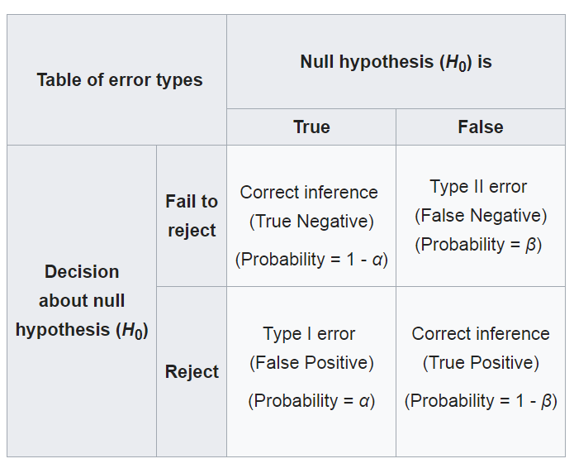
Type I and Type II Errors

Slide 15
Upper, Lower and Two Tailed Tests
The research or alternative hypothesis can take one of three forms. An investigator might believe that the parameter has increased, decreased or changed. For example, an investigator might hypothesize:
H₁: μ > μ ₀ , where μ₀ is the comparator or null value and an increase is hypothesized - this type of test is called an upper-tailed test;
H₁: μ < μ₀ , where a decrease is hypothesized and this is called a lower-tailed test; or
H₁: μ ≠ μ _{0,} where a difference is hypothesized and this is called a two-tailed test.
The exact form of the research hypothesis depends on the investigator's belief about the parameter of interest and whether it has possibly increased, decreased or is different from the null value. The research hypothesis is set up by the investigator before any data are collected.

Slide 16
Hypothesis Testing
When the observed value of the statistic is “extreme” in the sampling distribution that assumes H0 is true, we reject H0. Otherwise, we fail to reject H0.
Now comes the question of defining the “extreme” value.
There are 2 most commonly used methods:
Critical Value Method
P-Value Method

Slide 17
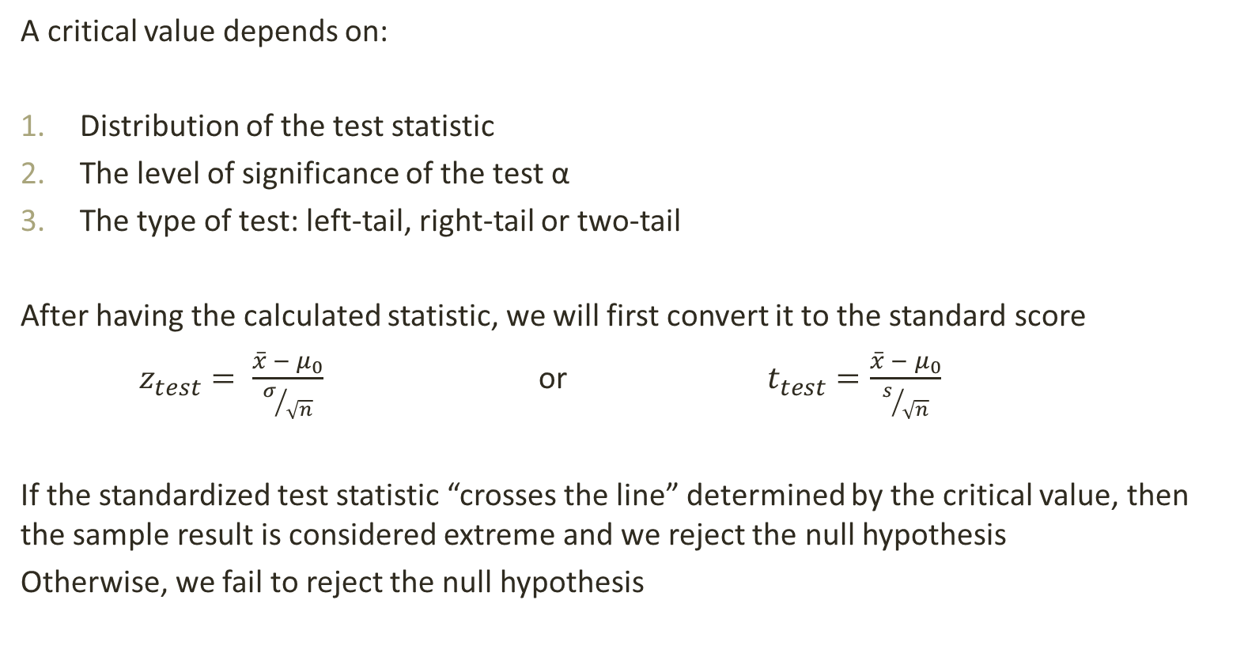
Critical Value Method
A critical value depends on:
Distribution of the test statistic
The level of significance of the test α
The type of test: left-tail, right-tail or two-tail
After having the calculated statistic, we will first convert it to the standard score
$z_{test}= \frac{\overline{x} − μ_{0}}{σ/{\sqrt{n}}}$ or $t_{test}=\frac{\overline{x} − μ_{0}}{s/{\sqrt{n}}}$
If the standardized test statistic “crosses the line” determined by the critical value, then the sample result is considered extreme and we reject the null hypothesis
Otherwise, we fail to reject the null hypothesis

Slide 18

Critical Value Method Example

Slide 19

Critical Value Method Example cont.

Slide 20

Critical Value Method Example cont.

Slide 21
P-Value Method
A P-value (or probability value) is the probability of getting a value of the sample test statistic that is at least as extreme as the one found from the sample data, assuming that the null hypothesis is true.
By extreme we mean: far from what we would expect to observe if the null hypothesis is true.
In other words, a small P-value indicates that observation of the test statistic would be unlikely if the null hypothesis is true.
The lower the P-value, the more evidence there is in favour of rejecting the null hypothesis.

Slide 22
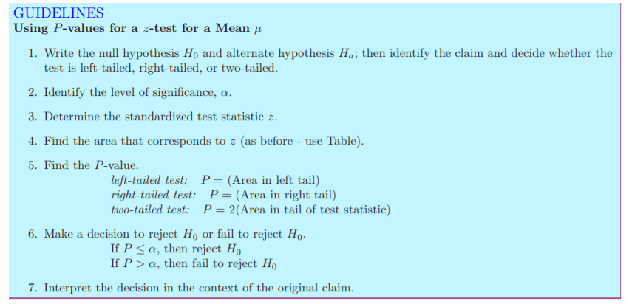
P-Value Method Guidelines

Slide 23
T-test
A t-test is a type of inferential statistic used to determine if there is a significant difference between the means of two groups, which may be related in certain features.
It is used to determine if 2 data samples come from the same distribution or not.
Calculating a t-test requires three key data values.
They include the difference between the mean values from each data set (called the mean difference),
The standard deviation of each group, and
The number of data values of each group
The outcome of the t-test produces a t-value. This calculated t-value is then compared against a value obtained from a critical value table (called the T-Distribution Table). This comparison helps to determine how likely the difference between the means occurred by chance or whether the data sets really have intrinsic differences
A large t-score indicates that the groups are different. A small t-score indicates that the groups are similar.

Slide 24
Further Reading
http://onlinestatbook.com/stat_sim/sampling_dist/
http://math.mercyhurst.edu/~griff/courses/m109/Lectures/sect7.2.pdf

Slide 25
Thank You

